Slide 1
Doubly LinkedList
Muhammed Tawfiq Chowdhury
Data Structure
Section 1 and Section 2

Slide 2
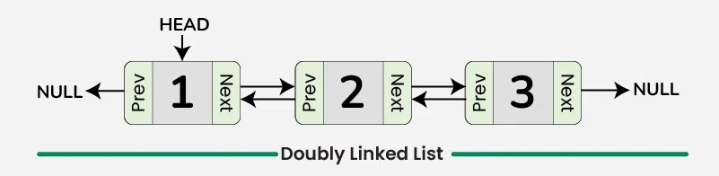
How it Works

Slide 3
Representation of Doubly Linked List in Data Structure
In a data structure, a doubly linked list is represented using nodes that have three fields:
Data
A pointer to the next node (next)
A pointer to the previous node (prev)

Slide 4

Node Structure

Slide 5
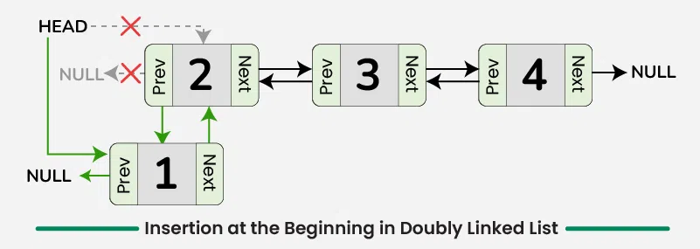
Insertion at the Beginning in Doubly Linked List

Slide 6
Insertion at the Beginning in Doubly Linked List
To insert a new node at the beginning of the doubly list, we can use the following steps:
Create a new node, say new_node with the given data and set its previous pointer to null, new_node->prev = NULL.
Set the next pointer of new_node to current head, new_node->next = head.
If the linked list is not empty, update the previous pointer of the current head to new_node, head->prev = new_node.
Return new_node as the head of the updated linked list

Slide 7
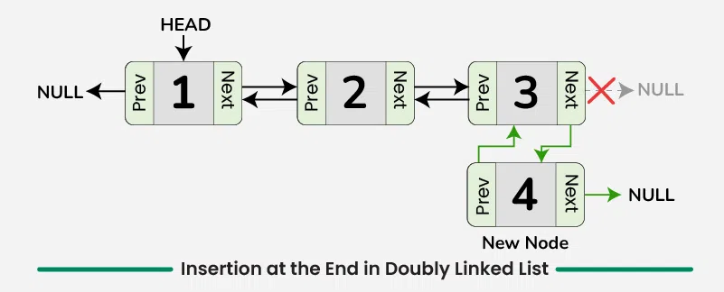
Insertion at the End of Doubly Linked List

Slide 8
Insertion at the End of Doubly Linked List
To insert a new node at the end of the doubly linked list, we can use the following steps:
Allocate memory for a new node and assign the provided value to its data field.
Initialize the next pointer of the new node to nullptr.
If the list is empty:
Set the previous pointer of the new node to nullptr.
Update the head pointer to point to the new node.
If the list is not empty:
Traverse the list starting from the head to reach the last node.
Set the next pointer of the last node to point to the new node.
Set the previous pointer of the new node to point to the last node.

Slide 9
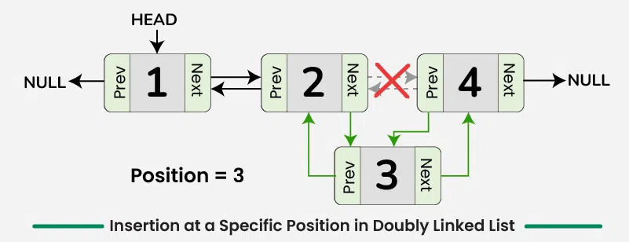
Insertion at a Specific Position in Doubly Linked List

Slide 10
Insertion at a Specific Position in Doubly Linked List
To insert a new node at a specific position,
If position = 1, create a new node and make it the head of the linked list and return it.
Otherwise, traverse the list to reach the node at position, say curr.
If the position is valid, create a new node with given data, say new_node.
Update the next pointer of new node to the next of current node and prev pointer of new node to current node, new_node->next = curr->next and new_node->prev = curr.
Similarly, update next pointer of current node to the new node, curr->next = new_node.
If the new node is not the last node, update prev pointer of new node’s next to the new node, new_node->next->prev = new_node.

Slide 11
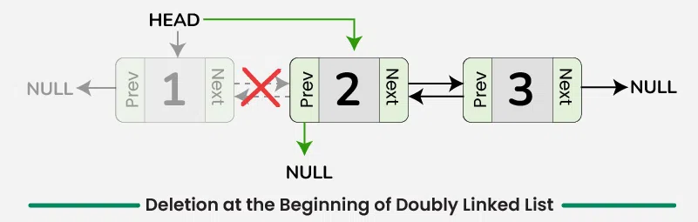
Deletion at the Beginning of Doubly Linked List

Slide 12
Deletion at the Beginning of Doubly Linked List
To delete a node at the beginning in doubly linked list, we can use the following steps:
Check if the list is empty, there is nothing to delete. Return.
Store the head pointer in a variable, say temp.
Update the head of linked list to the node next to the current head, head = head->next.
If the new head->prev is not NULL, update the previous pointer of new head to NULL, head->prev = NULL.

Slide 13
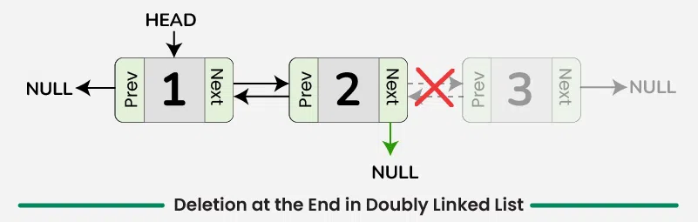
Deletion at the End of Doubly Linked List

Slide 14
Deletion at the End of Doubly Linked List
To delete a node at the end in doubly linked list, we can use the following steps:
Check if the doubly linked list is empty. If it is empty, then there is nothing to delete.
If the list is not empty, then move to the last node of the doubly linked list, say curr.
Update the second-to-last node’s next pointer to NULL, curr->prev->next = NULL.
Free the memory allocated for the node that was deleted.

Slide 15
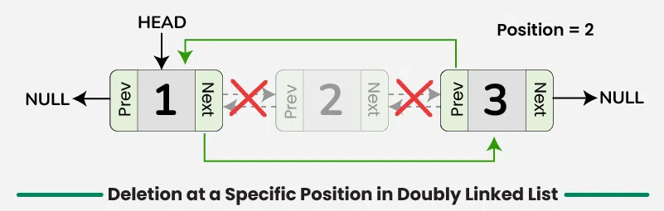
Deletion at a Specific Position in Doubly Linked List

Slide 16
Deletion at the End of Doubly Linked List
To delete a node at a specific position in doubly linked list, we can use the following steps:
Traverse to the node at the specified position, say curr.
If the position is valid, adjust the pointers to skip the node to be deleted.
If curr is not the head of the linked list, update the next pointer of the node before curr to point to the node after curr, curr->prev->next = curr-next.
If curr is not the last node of the linked list, update the previous pointer of the node after curr to the node before curr, curr->next->prev = curr->prev.
Free the memory allocated for the deleted node.

